Slide 1
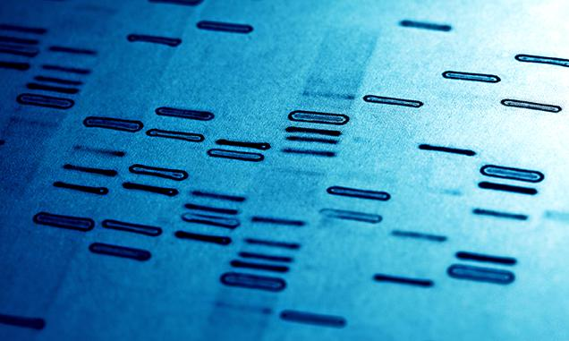

‹#›
All rights Reserved
Cengage/NGL/South-Western © 2016

Slide 2
Chapter 6 Fingerprints By the end of this chapter you will be able to:
6.1 Outline the history of fingerprinting.
6.2 Describe the characteristics of fingerprints.
6.3 Compare and contrast the basic types of fingerprints.
6.4 Describe how criminals attempt to alter their fingerprints.
6.5 Present and refute arguments that question fingerprint evidence reliability.
‹#›

Slide 3
Chapter 6 Fingerprints By the end of this chapter you will be able to:
6.6 Summarize the proper procedures for collecting fingerprint evidence.
6.7 Describe the latest identification technologies.
6.8 Determine if a fingerprint is consistent with a fingerprint on record.
6.9 Lift a latent print.
6.10 Prepare a ten card and analyze the ridge patterns of the prints.
‹#›

Slide 4
Chapter 6 Vocabulary
arch
core
delta
fingerprint
IAFIS (Integrated Automated Fingerprint Identification System)
latent fingerprint
loop
minutiae
patent fingerprint
plastic fingerprint
ridge count
ridge pattern
ten card
whorl
‹#›

Slide 5
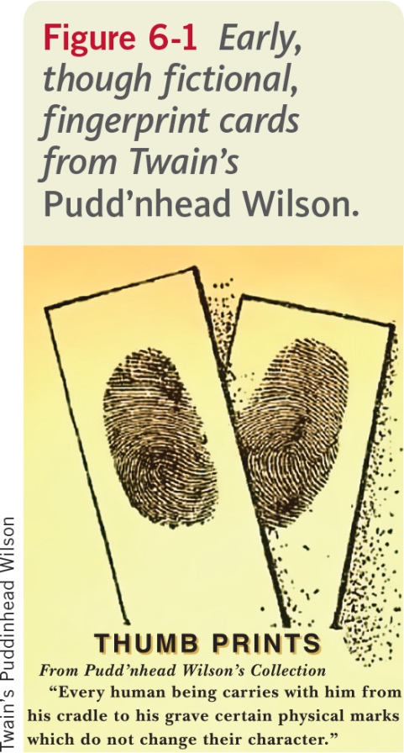
Introduction
Pudd’nhead Wilson was published in 1894.
Pudd’nhead Wilson states that a suspect’s fingerprints are:
“his signature, his physiological autograph, so to speak, and this autograph cannot be counterfeited, nor can he disguise it or hide it away, nor can it become illegible by the wear and mutations of time.”
‹#›

Slide 6
History
Ancient cultures used fingerprints as personal markings.
1792-1750 B.C. — Fingerprints were pressed into clay tablet contracts.
1684 — Dr. Nehemiah Grew described the patterns he saw on human hands under a microscope.
1788 — Johann Christoph Andreas Mayer described that fingerprints are unique to each individual.
1823 – Jan Evangelist Purkyn described nine distinct fingerprint patterns.
‹#›

Slide 7
History (continued)
1856 — Sir William Herschel began collecting fingerprints.
1879 — Alphonse Bertillon created a way to identify criminals that were repeat offenders.
1888 — Sir Francis Galton verified that fingerprints do not change with age.
1896 — Sir Edmund Richard Henry (and colleagues) created a system that divided fingerprint records into groups. Their work was the basis of the ten card.
‹#›

Slide 8
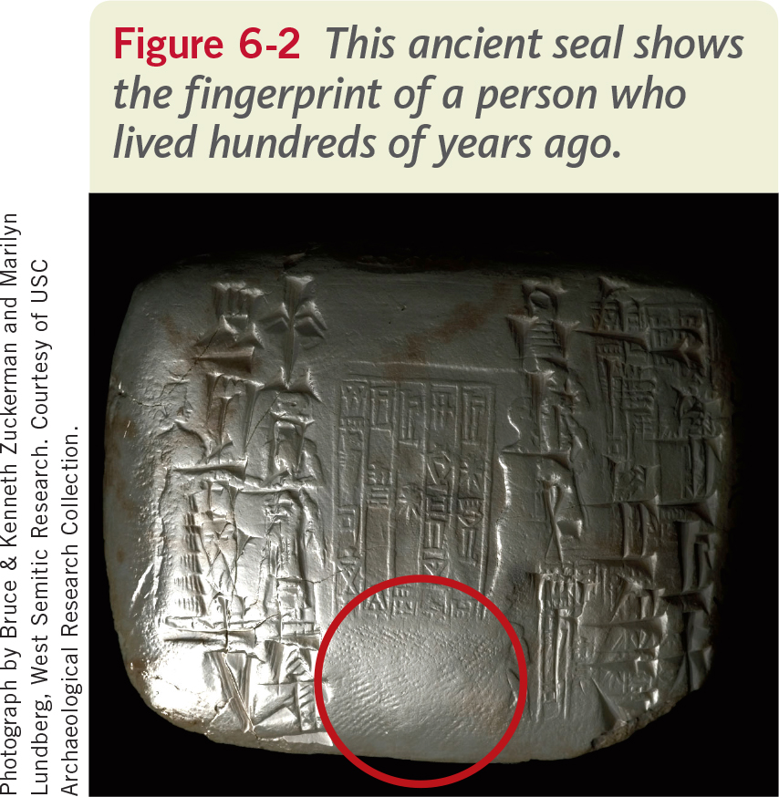
‹#›

Slide 9
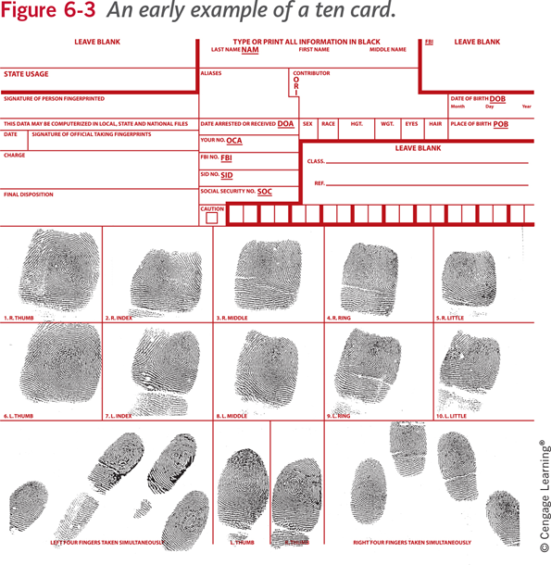
‹#›

Slide 10
History (continued)
2012 — The FBI-maintained IAFIS system had more than 76 million computerized fingerprints, mugshots, scars, tattoo photos, and other identification records.
The system will soon be enhanced by Advanced Fingerprint Identification Technology (AFIT).
2013 — The FBI was integrating the ability to compare crime-scene palm prints with prints collected at the time of arrest.
About 20-30% of latent prints at a crime scene come from the palm or side of the hand from the little finger to the wrist.
‹#›

Slide 11
What Are Fingerprints?
Formation of Fingerprints
Fingerprints are formed beginning at the 10th week of gestation.
The development of fingerprints happens in the basal layer of skin.
Fingerprints are protected by the outer layer of epidermis.
‹#›

Slide 12
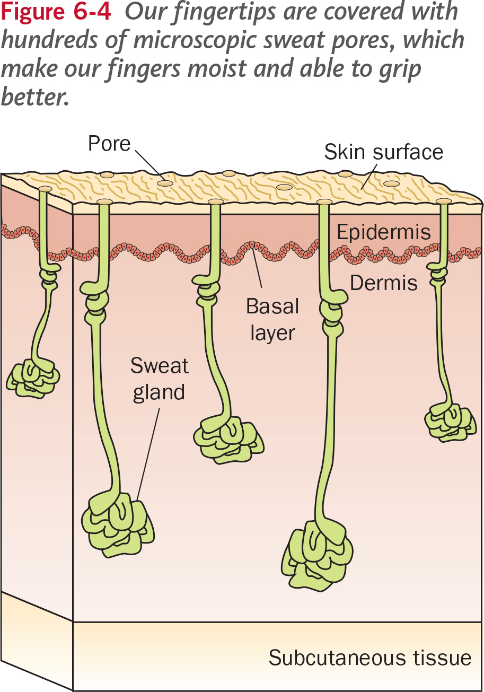
‹#›

Slide 13
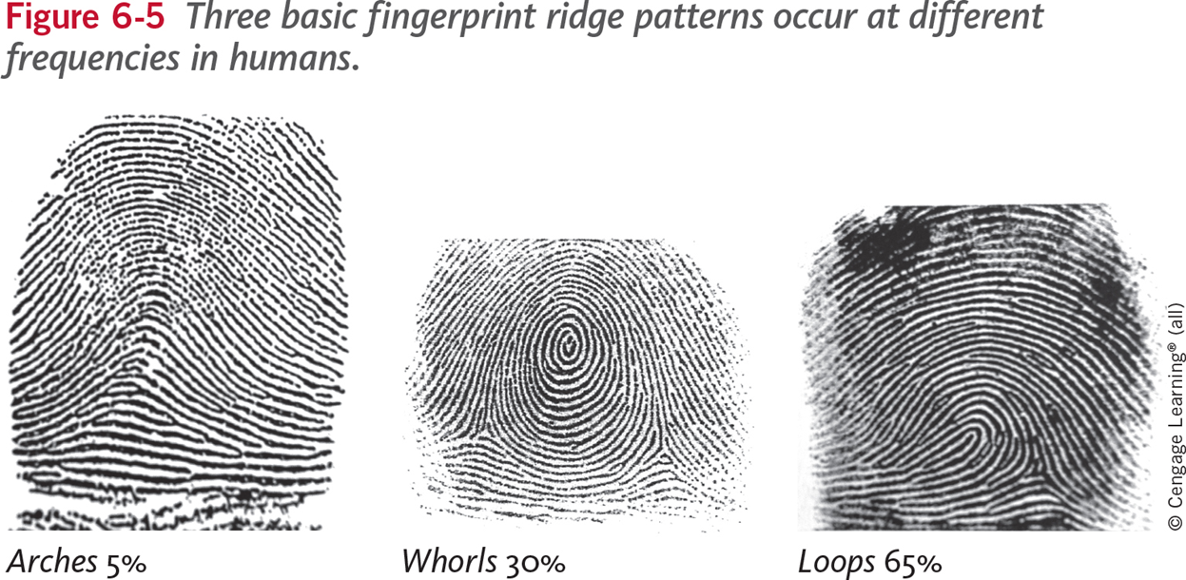
Characteristics of Fingerprints
‹#›

Slide 14
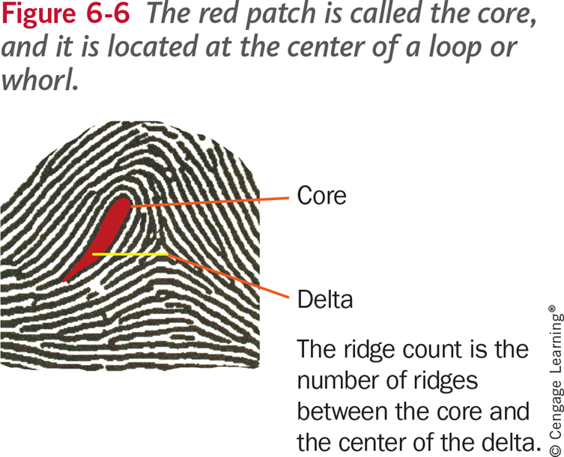
Characteristics of Fingerprints (continued)
‹#›

Slide 15
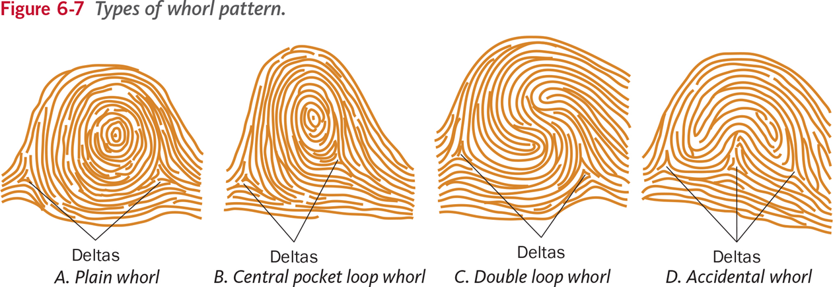
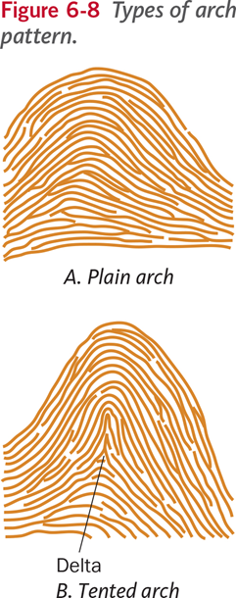
Characteristics of Fingerprints (continued)
‹#›

Slide 16
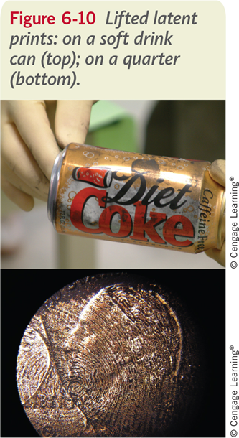
Types of Fingerprints
Patent fingerprints
Plastic fingerprints
Latent fingerprints
‹#›

Slide 17
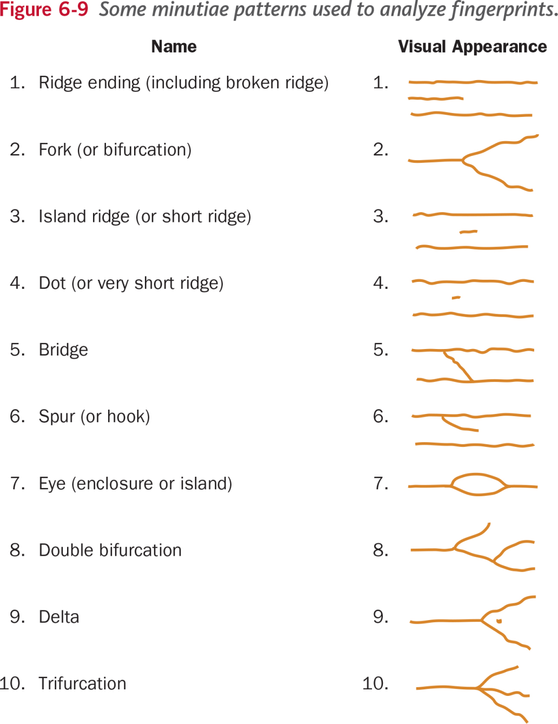
‹#›

Slide 18
Fingerprint Forensic FAQs
Can fingerprints be altered or disguised?
How reliable is fingerprinting as a means of identification?
How are fingerprints analyzed?
How are latent fingerprints collected?
‹#›

Slide 19
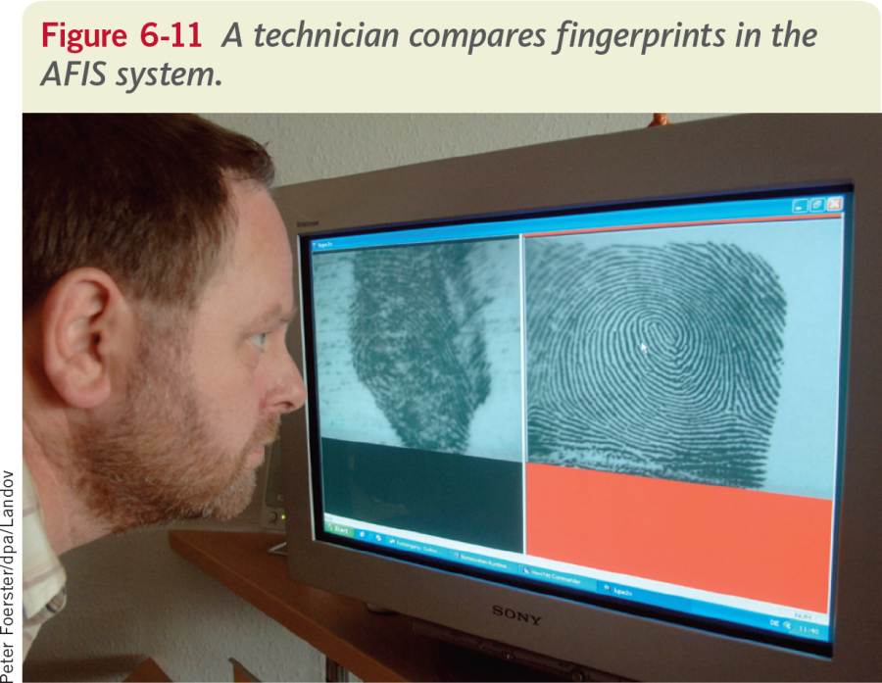
‹#›

Slide 20
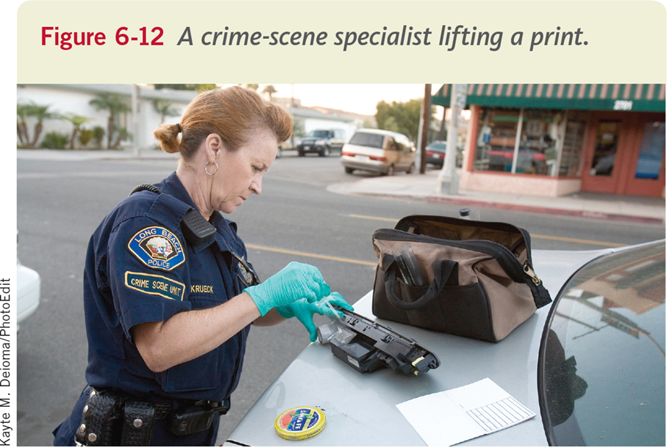
‹#›

Slide 21
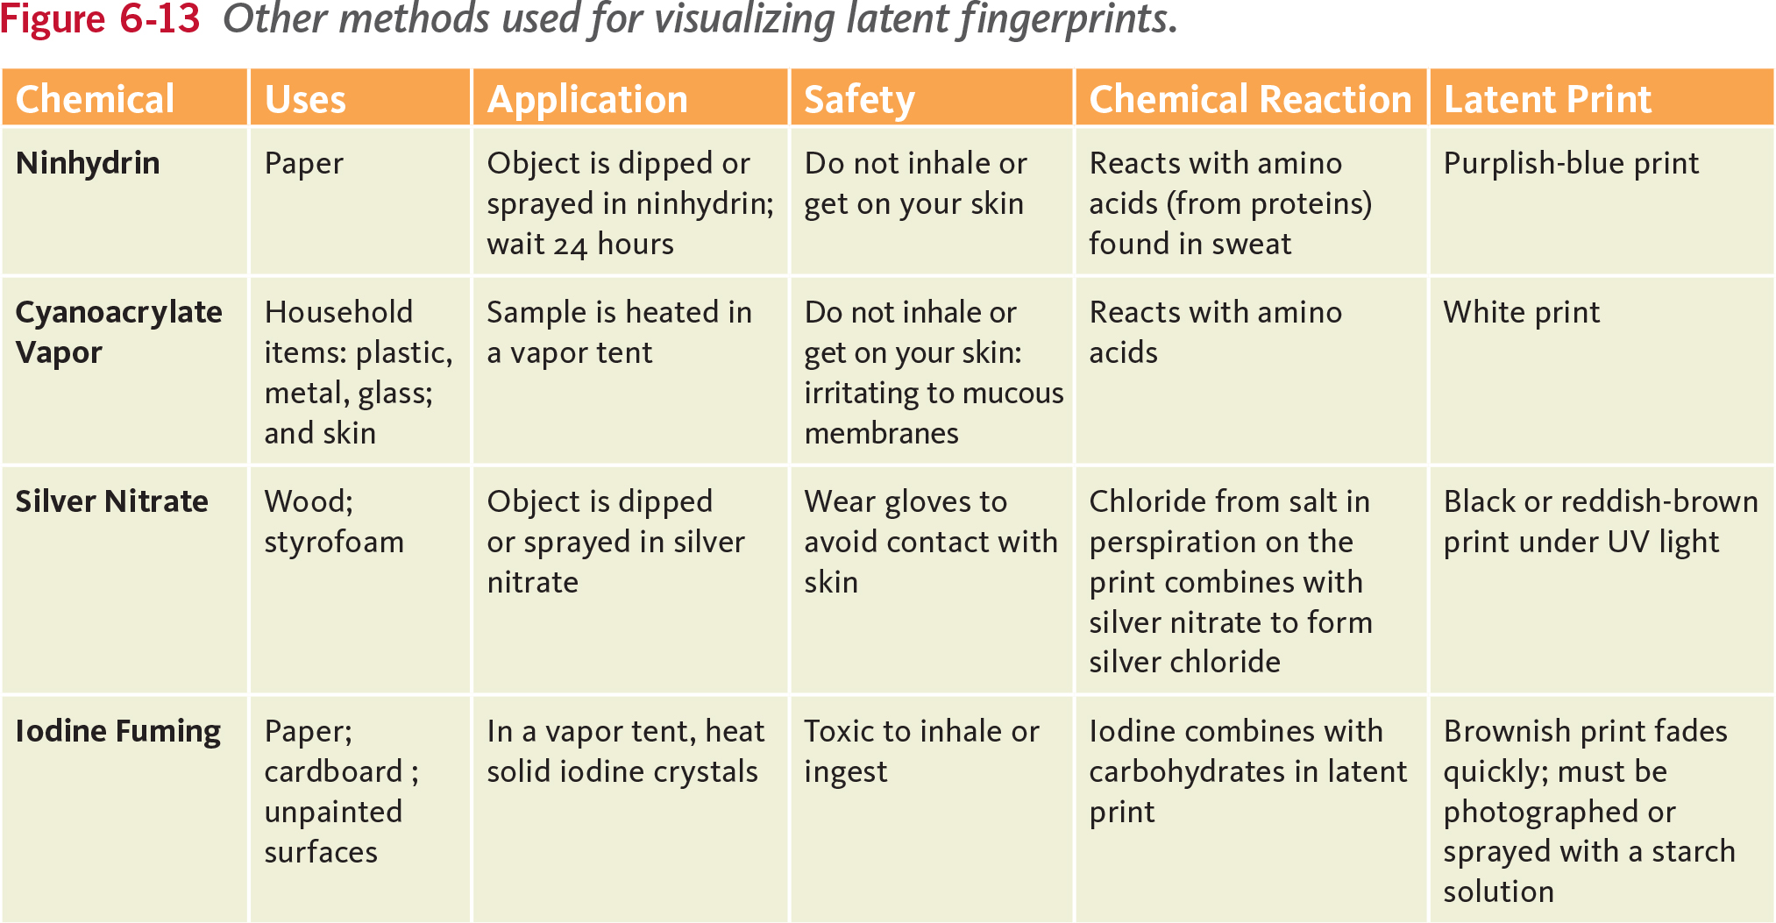
‹#›

Slide 22
The Future of Fingerprinting
Fingerprints can be scanned at a resolution of 500 to 1000 dots per inch.
Nanoparticles have been added to fingerprint powders making poor patterns appear even sharper.
The materials that we touch leaves trace evidence on our fingers and hands, which is in turn is left behind on the objects we touch.
‹#›

Slide 23
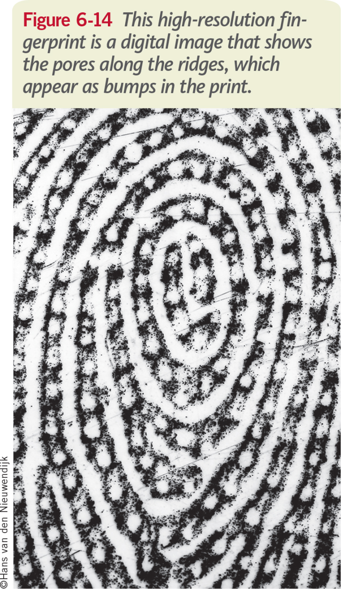
‹#›

Slide 24
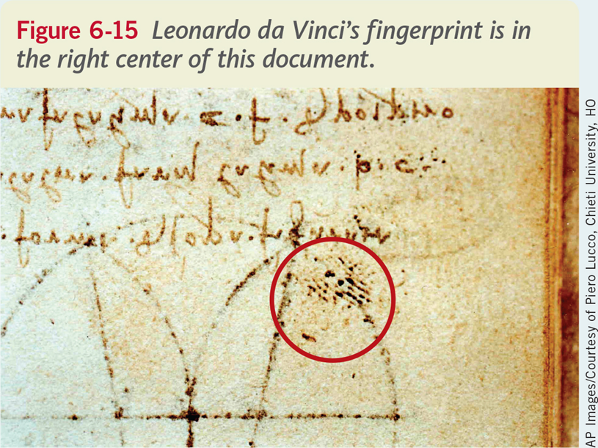
‹#›

Slide 25
Summary
Humans have noticed the patterns on their hands for thousands of years, but it was not until 1684 that these patterns were described in detail. In the mid-1800s, the idea of a fingerprint’s uniqueness was studied, and the application of fingerprints to an identification system began. By the late 1800s, two effective systems were being used to identify criminals, and fingerprints were being collected as evidence in crimes.
The elevated regions in a fingerprint are called friction ridges. Fingerprints consist of several main ridge patterns, including whorls, loops, and arches. They have a core, which is an area where ridges separate or unite after running in a parallel direction. The triangular region located near a loop pattern, or whorl, is called a delta.
Fingerprints are formed in the womb at about week 10 of gestation. They are formed between two layers of skin, and their shape does not change during a person’s lifetime. They are unique to an individual. Not even identical twins have identical fingerprints.
‹#›

Slide 26
Summary (continued)
Fingerprints left on an object are created by the naturally occurring ridges in the skin of fingertips and secretions from sweat glands that leave small amounts of oils and salts when the ridges are pressed against an object. The residues leave an impression of the ridges found on the finger of the donor.
The basic types of fingerprints are patent (visible) fingerprints, plastic (indentation) fingerprints, and latent (not visible to the unaided eye) fingerprints. They are characterized as loops, whorls, or arches, and are compared on the basis of their minutiae.
Criminals have sought to alter their fingerprints with chemicals, surgery, and superficial destruction. Some fingerprints can temporarily be altered by long-term contact with rough surfaces. Attempts at permanent fingerprint alteration have not been successful.
‹#›

Slide 27
Summary (continued)
Mistakes in fingerprint analysis have led to wrongful convictions, mostly because of human error. New forensic standards are being developed through the Scientific Working Groups and the Organization of Scientific Area Committees.
The Integrated Automated Fingerprint Identification System (IAFIS) is a national database that holds more than 76 million fingerprint, identifying mark, and criminal history records.
Fingerprints can be collected from surfaces by dusting them with certain powders and impressing them on tape, or putting them into contact with certain chemicals that help reveal the fingerprints.
‹#›

